Slide 1

Spoiled Beverage Detector
Jahangir Esfandiari
Rahmani Rahmani
Kymbat Talant
Vanessa Mathew
,

Slide 2
Outline
Introduction/Objective
Early Findings (fruit juices and milk)
Current Technologies
Type of Drink + Sensor
Possible Solutions
Option 1 (gas sensor)
Option 2 (pH meter)
Components makeup
Demonstration

Slide 3
Introduction/Objective
Consuming Expired Drinks
Effect: Stomach cramp, fever, vomiting, nausea, diarrhea, etc
Option to detect early spoilage takes time
Children not aware of the early signs of expired drinks
Objective: smart cup should be developed in order to detect expired drinks and display the results fast.

Slide 4
Early Findings: Fruit Juices Property
Fruit juices have pH in the acidic range (<4.5) serving as important barrier for microbial growth.
Freshly expressed juice, is highly susceptible to spoilage, in fact more so than whole fruit
Unprotected by skin or cell walls, fluid components are thoroughly mixed with air and microorganisms from the environment.
Juices | pH range | Mean
Orange | 4.19–4.50 | 4.34
Sweet lime | 4.70–5.47 | 5.08
Carrot | 5.76–6.03 | 5.89
Notes:
Source: Alicyclobacillus spp. Control in the Fruit Juice Industry
Microbiology of soft drinks and fruit juices (P. Wareing and R.R.) Davenport

Slide 5
Critical factors affecting the spoilage of juices
Intrinsic | Extrinsic
juice pH | storage temperatures and times
water activity | relative humidity conditions during storage and packaging material characteristics.
Effects:
cloud loss
development of off-flavors
CO2 production
changes in color, texture, and appearance
Notes:
Source: Microbiology of soft drinks and fruit juices (P. Wareing and R.R.) Davenport

Slide 6
Fruit Juices + Milk Microorganisms
Fruit juices contain a microflora which is normally present on the surface of fruits during harvest and postharvest processing which include transport, storage, and processing.
However, food borne pathogens such as E. coli and Salmonella survive in acidic environment of fruit juices due to acid stress response
Common pathogens/bacteria seen both in milk and juice:
Salmonella, E. coli., Pseudomonas (similar to Toxin Alert Inc)
Microorganisms in spoiled fruit juices
Yeasts
Bacteria
Molds
Mycotoxins
Pathogens
Notes:
Source: - Emerging Preservation Techniques for Controlling Spoilage and Pathogenic Microorganisms in Fruit Juices
- Microbes Associated with Freshly Prepared Juices of Citrus and Carrots

Slide 7
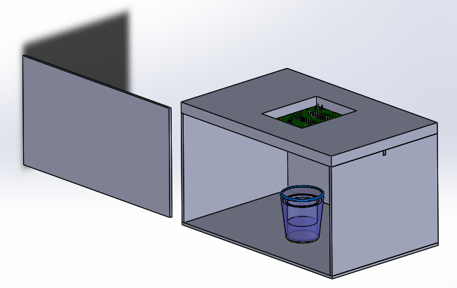
Option 1 (Gas Sensor)
Source Drawing: Arduino Part [1] , Cup Part [2]
Drawing assembled by Vanessa.M

Slide 8

Option 1 (Gas Sensor)
Source Drawing: Arduino Part [1] , Cup Part [2]
Drawing assembled by Vanessa.M

Slide 9
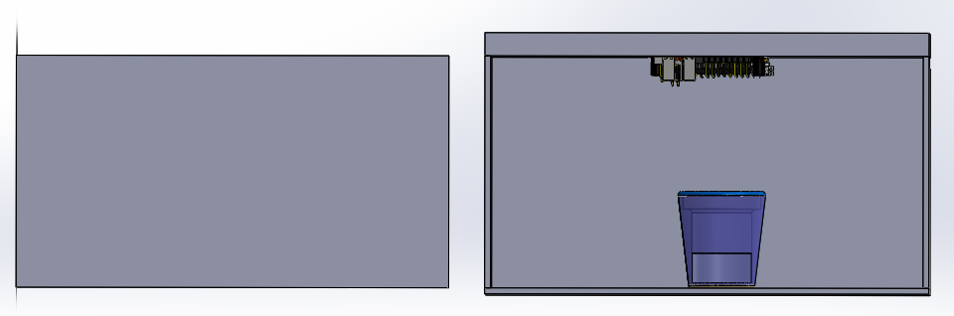
Option 1 (Gas Sensor)
Source Drawing: Arduino Part [1] , Cup Part [2]
Drawing assembled by Vanessa.M

Slide 10
References
[1] https://grabcad.com/library/circuit-board-pcb-mock-example
[2] https://grabcad.com/library/agian-glass-1
[3]
[4]

